Slide 1
AS OUTRAS MOEDAS

Slide 2
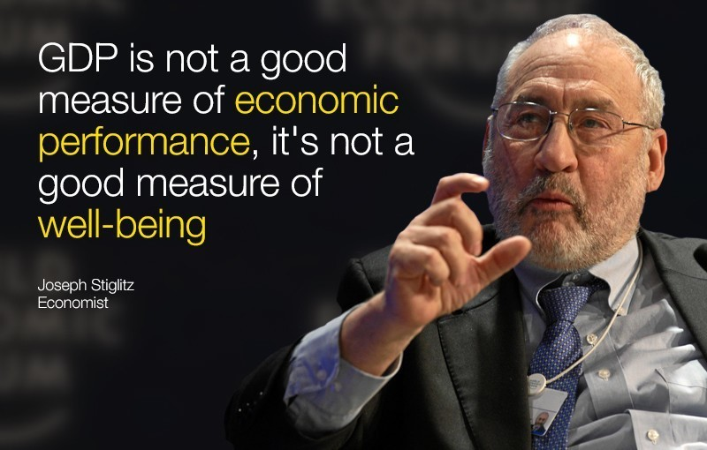
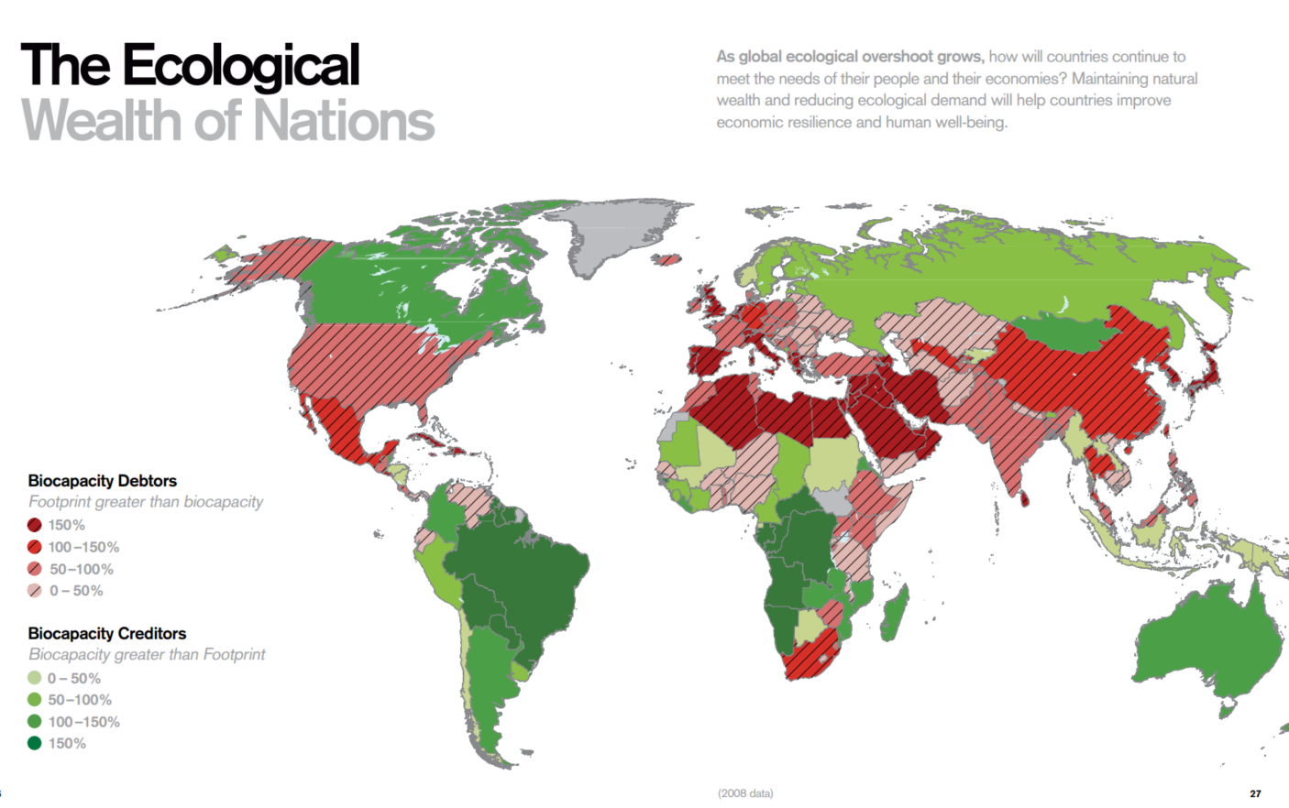
Pensar para além do…
“What we measure informs what we do. And if we’re measuring the wrong thing, we’re going to do the wrong thing.”

Slide 3
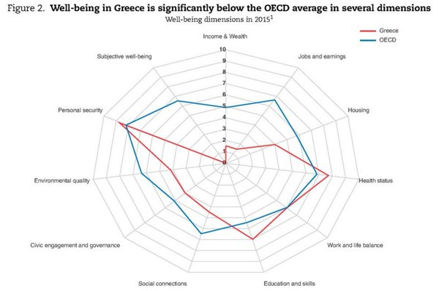
Happy Planet Index (HPI)
The Happy Planet Index measures what matters: sustainable wellbeing for all. It tells us how well nations are doing at achieving long, happy, sustainable lives.
Gross National Happiness (GNH)
Is a measurement of the collective happiness in a nation.
The Multidimensional Poverty Index (MPI)
The Report features a new multidimensional poverty measure that complements income-based poverty assessments by looking at multiple factors at the household level, from basic living standards to access to schooling, clean water and health care. About 1.7 billion people—fully a third of the population in the 104 countries included in the MPI—are estimated to live in multidimensional poverty, more than the estimated 1.3 billion who live on $1.25 a day or less.
Inequality-adjusted Human Development Index (IHDI)
This measure adjusts the HDI for inequality in distribution of each dimension across the population. The IHDI accounts for inequalities in HDI dimensions by ‘discounting’ each dimension’s average value according to its level of inequality. The IHDI equals the HDI when there is no inequality across people but is less than the HDI as inequality rises. In this sense, the IHDI is the actual level of human development (accounting for this inequality), while the HDI can be viewed as an index of ‘potential’ human development (or the maximum level of HDI) that could be achieved if there was no inequality. The ‘loss’ in potential human development due to inequality is given by the difference between the HDI and the IHDI and can be expressed as a percentage. For the first time, the 2010 Human development Report examined HDI data through the lens of inequality, adjusting HDI achievements to reflect disparities in income, health and education.

Slide 4
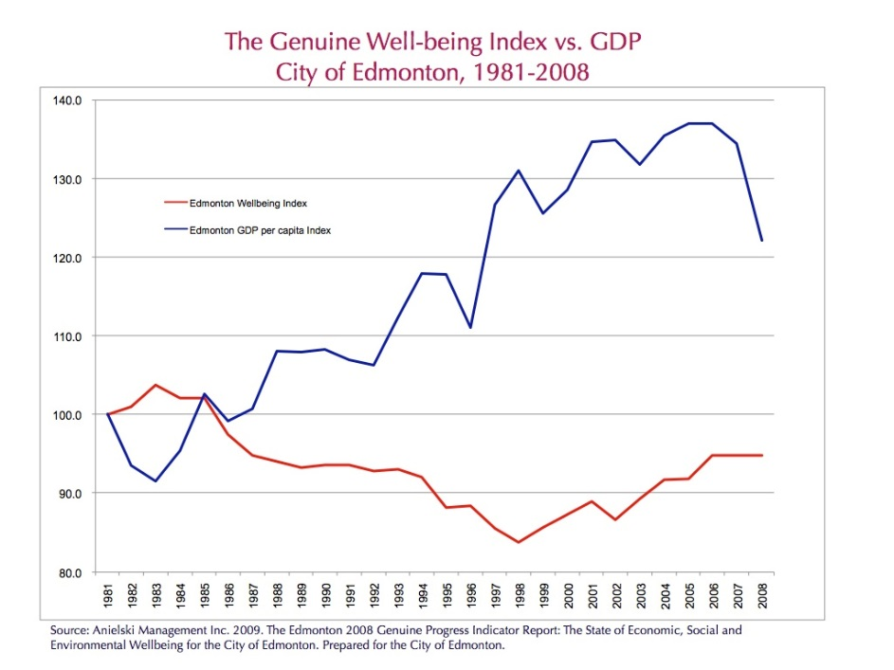
Alberta
Genuine Progress Indicator
Edmonton

Slide 6
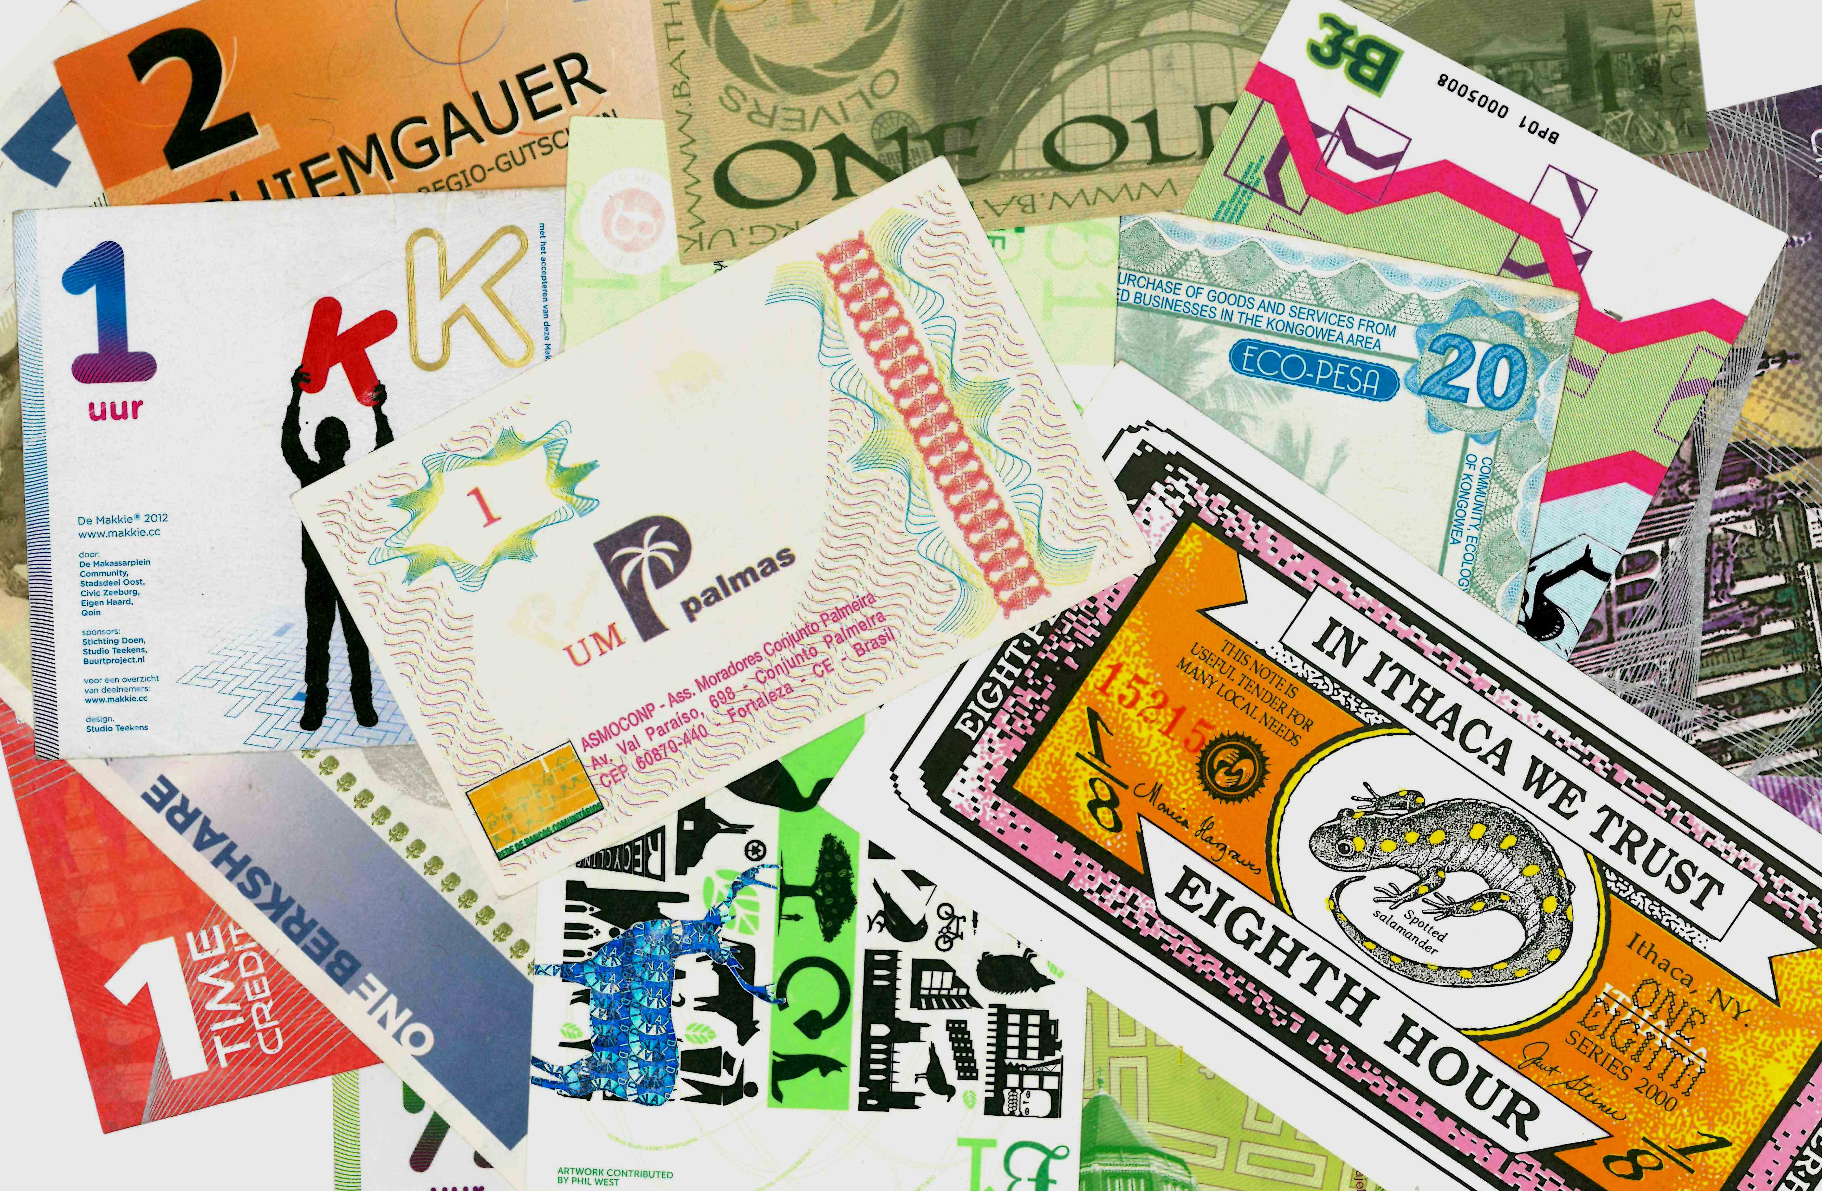

Slide 7
Classifying “CCs”: Community, complementary and local currencies’ types and generations Jérôme Blanc

Slide 8
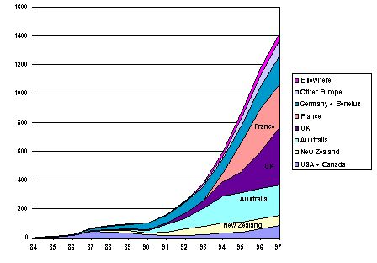

Slide 9
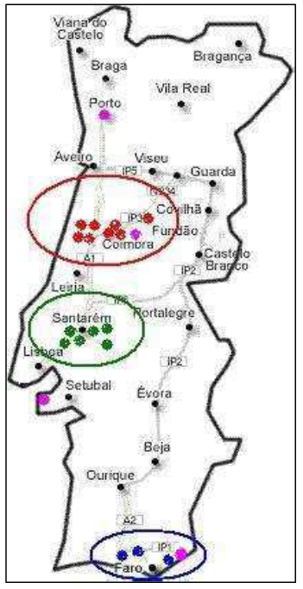
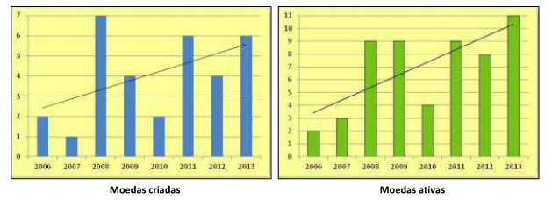
5.14. - Swap
5.15. - Feijão
5.16. - ESECO
5.17. - Pomba
5.18. - Pombalino
5.19. - Aleixo
5.20. – Jardim
5.21. - Giro
5.22. - Rio
5.23. – Virtas
5.24 – Mayor
5.25 – Estrela
5.26 – Canguru
5.27 – Gaivota
5.28 – Brinca
5.28 – Mor
5.30 - Coroa
5.1. - Granja
5.2. - Solidário
5.3. - Justa
5.4. - Torga
5.5. - Sorriso
5.6. - Sol
5.7. - Campino
5.8. - Esito
5.9. - Diabitas
5.10. - Saurius
5.11. - Beijinho
5.12. - Crialito
5.13. - Morango
Garcia, Armando (2014), Notafilia: Moedas Comunitárias em Portugal, Lisboa

Slide 10
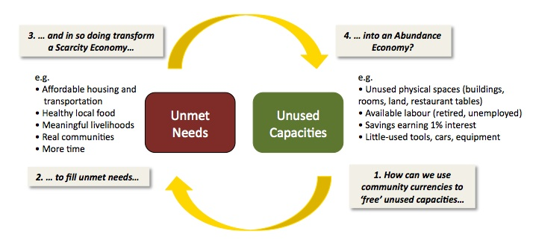

Slide 11
https://www.youtube.com/watch?v=CFlolsjwdWY

Slide 13
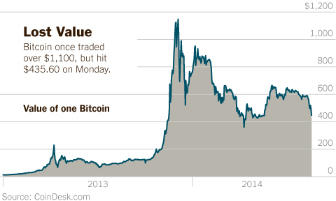
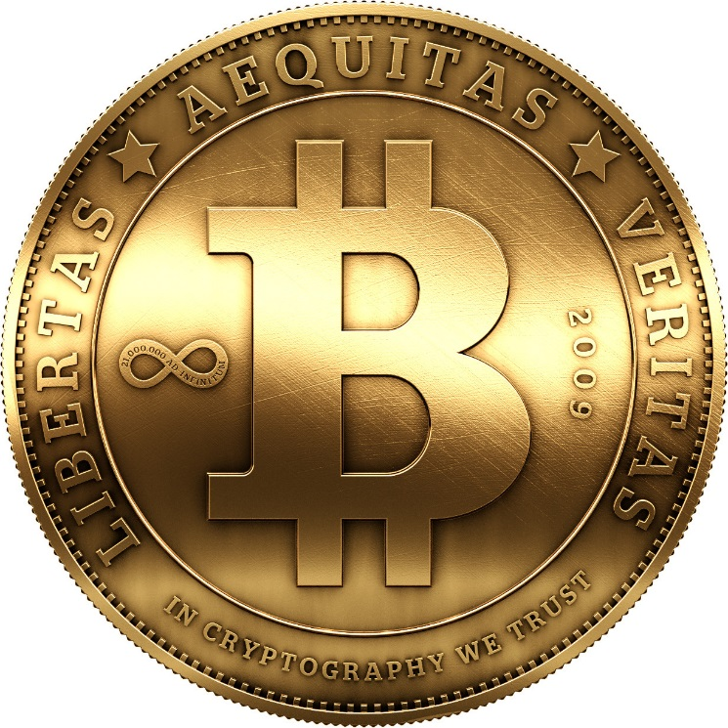
Criptocurrencies

Slide 14
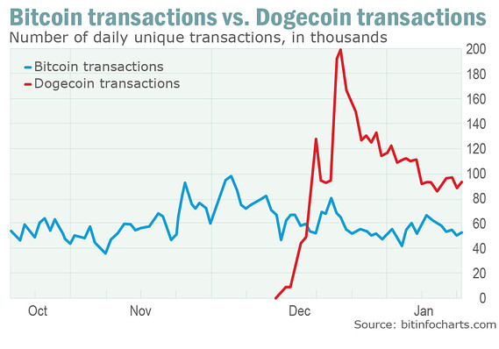

Slide 15
https://www.youtube.com/watch?v=r_URg3Y-evE

Slide 16
O DESIGN MONETÁRIO
Moeda | Meio de transação | Unidade de Medida | Circulação Entrada | Saída | Colateral | Convertibilidade | Segurança | Incentivos/ desincentivos
Bitcoin | virtual | dollar | Mineração ou compra | Venda em mercado ou compra de bens ou serviços | dollar | Taxa de conversão flexivél em relação ao dollar | Limites à emissão, emissão e controlo descentraliados | Custos de transação reduzidos
Bristol Pund | Txt, notas | libra | Compra de bristol pounds, | Troca por bens ou serviços, ou conversão | libra | Total para os comerciantes, reduzida para os particulares | Autarquia e o banco local como parceiros e convertibilidade | Grande adesão por parte dos comerciantes
Fureai Kippu | vouchers | Uma hora de trabalho | Voucher oferecidos pelas ONG | Utilização em serviços | Confiança nas ONG | nula | Confiança nas ONG
Wir | virtual | Franco suiço | Inscrição na rede e encontro com um parceiro para prestação ou recepção de bens ou serviços | Liquidação do saldo em aberto e saída da rede | Franco suiço | nula | Disponivel apenas para organizações | Grande número de membros

Slide 17
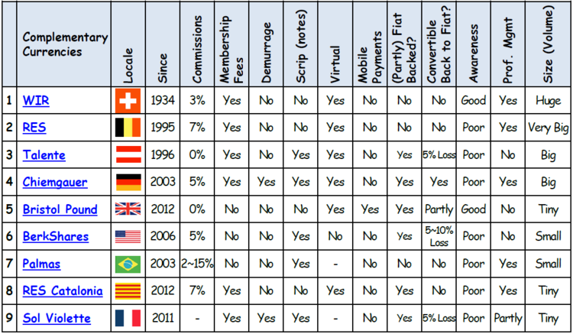
Source: de la Rosa and Stodder

